Slide 1


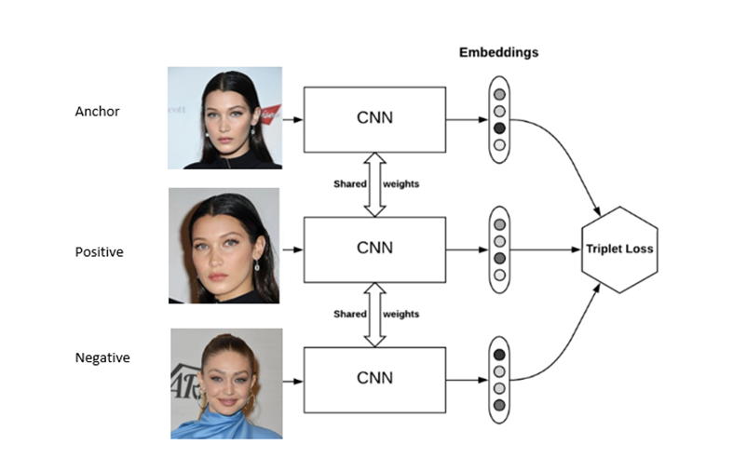
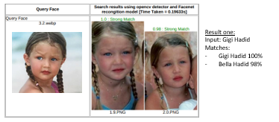
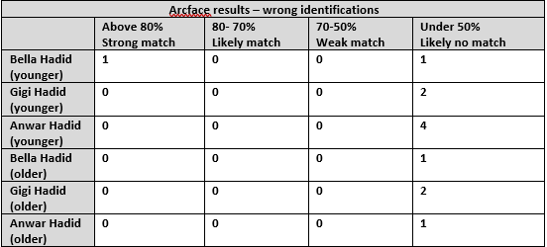
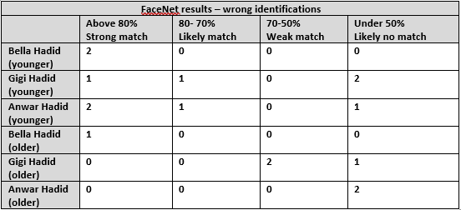
Face recognition in siblings
Marim Sabah
University of Bradford
ABSTRACT
Facial recognition has become increasingly more popular in the last decade and in this study, I investigated it on siblings by using a sibling database and testing it on the models FaceNet and ArFace.
Fig.1 FaceNet model- how it works.
METHODS
I complied a dataset of the siblings, I did a mixture of younger photos of them and older photos to see if siblings at a younger age match more and to see the limits. I was given a program coded by my mentors; this was run on google colab. I had to run each part which included installing pre-requisites, importing the operating system, mounting my personal google drive so I can access my files, specifying the location of the app in my drive, and then running it to load the face recognition app. I then would choose a picture from the web from one of the people in my dataset to see if the models detect any other images that are also them. I then copied the dataset pat from the file in the server, chose the OpenCV model, and tested between the models.
RESULTS (CONTINUED)
With ArcFace, there was one complete 100% incorrect identification, and the rest under 50% (unlikely), with a total of eight out of fifteen (8/15) matches being wrong classifications. With the older images of the Hadid siblings, there was a complete 100% inaccurate match, and the rest of the wrong matches were under 40% likely, with a total of five out of nineteen (5/19) being wrong classifications.
In comparison, for FaceNet, there was a 44% accuracy (all percentages rounded) rate for younger images of the siblings and a 63% inaccuracy rate for the older pictures of them. For ArcFace, there was a 47% accuracy rate for the younger images of the siblings and a 74% accuracy rate for the older pictures of them. This shows that FaceNet has the least accuracy as it made the most wrong identifications and classified more of the siblings as the same person.
FURTHER WORK
To make this experiment more precise, a dataset of siblings that have the same expressions and have no features exaggerated, as well as the photos being taken in the same angel would make it fairer. To extend this work, a larger sibling database would be important to evaluate the performance of the models and see how accurate face recognition is in distinguishing between different pairs of siblings. A further step in this study could also be to evaluate the accuracy of different models like VGGFace and Face ++.to have a wider testing range.
CONCLUSIONS
Overall, the results have shown that facial recognition models are robust in distinguishing sibling pairs when full-frontal-face are provided, but the accuracy of it varies depending on factors like age and possibly gender. First of all, it was shown that the ArcFace model was more accurate in distinguishing between siblings with a 3 % higher accuracy for the younger pictures and a whole 11 % accuracy higher for the older age pictures. In general, both the Facenet and ArcFace are inaccurate in distinguishing between siblings as both have strong incorrect matches classifying each other as their siblings.
AIMS
I first aimed to find out the steps in facial recognition and then I did my own experiment by using their face recognition app, I chose to focus on siblings to find out the limits in not identifying as each other. I used the models FacNet and ArcFace to test out their accuracy, see their differences and learn how they work. With the data I collected, I calculated their accuracy for both models and both younger and older images. This work has shown that distinguishing siblings is a challenging problem,
RESULTS
With FaceNet, there was one complete 100% incorrect identification, six negative classifications that were above 80% matched, and two between 80-60%, with a total of nine out of sixteen (9/16) matches being wrong classifications, above half. With the older images of the Hadid siblings, there was also one complete 100% inaccurate identification, two above 80%, two between 80-60%, a total of seven out of nineteen (7/19) matches being wrong classifications.
REFERENCES
Brownlee, J., 2019. How to Develop a Face Recognition System Using FaceNet in Keras. Kumar, D., 2019. Introduction to FaceNet : A Unified Embedding for Face Recognition and Clustering. Cochard, D., 2021. ArcFace : A Machine Learning Model for Face Recognition. Goel R, Mehmood I, Ugail H. A Study of Deep Learning-Based Face Recognition Models for Sibling Identification. Sensors (Basel). 2021
DISCUSSION
It’s shown that younger siblings are harder to distinguish between most likely because their features look more alike as they haven’t fully grown into their individual faces yet. There was a total of five strong matches between the younger siblings above 80% using the FaceNet model, even a 100% match between Bella Hadid and Anwar Hadid whereas for the older pictures of them there were no strong matches but one 80% likely match between Bella Hadid and Gigi Hadid. This shows the much higher accuracy with older siblings, but that could be because of their environment changes and them changing their looks in the cosmetic area. From my results, it seemed like there were more same-gender wrong classifications than opposite gender which could be because the females have more ‘feminine’ features and the male brother has more ‘masculine’ features.
INTRODUCTION
I set out to discover the limitations in face recognition when it comes to siblings, to see if it can distinguish between them when they have similar genetics and features .This is even more challenging when factors such as gender, age, and even expressions come. This is why I aimed to test the models on siblings of these different factors to see if they can work on more complex sibling subjects. Questions I wanted to answer were: can it recognize between siblings at a younger age when their features aren’t fully grown to their faces yet? Can it distinguish between siblings when they’re older? We as humans can easily recognize between siblings and detect who is who due to our human intelligence, but can computers?
ACKNOWLEDGEMENTS
I’d like to thank my supervisors Dr Hassan Ugail and Dr Ifran who provided lots of resources and help. Provided extra meetings for me to mentor me. I would like to extend my thanks to Paula who provided me with this amazing opportunity and helped me submit my application as well as her help in how to write this report. Even further I want to thank the whole of the Nuffield Research Foundation for all the support and experiences.

